Slide 1
PROJECT 9 / PHASE 1
Indoor location
prediction from
Wi-Fi signals
A visual walkthrough of the AML project and its five workstreams
Building · Floor · Coordinates
Signal2Space
Notes:
This presentation explains the implemented AML phase only. Work is organized into five pipelines, from shared data preparation through task-specific Random Forest models and integration. The deck uses Member 1–5 labels because personal names were not provided.

Slide 2
Problem and project overview
Predict building, floor, and position from one sparse Wi-Fi fingerprint.
Wi-Fi scan
Shared features
Three ML tasks
One evaluation
520 access-point RSSI fields
most readings are absent
scaled signal + presence
+ six signal summaries
building class · floor class
longitude + latitude
held-out task scores
+ joint error analysis
19,937
1,111
UJIIndoorLoc · 529 columns
training/reference rows
supplied held-out rows
520 WAP fields · 4 targets · 5 metadata fields
PROJECT 9 • AML VIVA • 02
Notes:
The provided files contain 19,937 training/reference rows and 1,111 held-out rows. Each has 529 columns: 520 WAP RSSI fields, four targets (building, floor, longitude, latitude), and five metadata fields. The tasks are two classifications and a two-coordinate regression. Sources: raw CSV schema, ML_01 notebook, UCI UJIIndoorLoc dataset.

Slide 3
Evaluation design and held-out boundary
Use internal validation to select settings; reserve the supplied file for final reporting.
Internal training
Training/reference
16,085 rows · fit scaler
and estimator
19,937 supplied rows
Freeze settings
Final evaluation
Select without using
final held-out labels
1,111 supplied
held-out rows
Internal validation
3,852 rows · compare
candidates
Group key: BUILDINGID + FLOOR + SPACEID
Seed 42 · 588 / 147 disjoint composite groups · no scaler fit on held-out rows
PROJECT 9 • AML VIVA • 03
Notes:
The training/reference file is split with GroupShuffleSplit, test_size 0.20, random_state 42, using the composite group (BUILDINGID, FLOOR, SPACEID). This yields 16,085 internal-training rows from 588 groups and 3,852 internal-validation rows from 147 disjoint groups. The scaler and model fit only on internal training. Internal validation selects settings. The separate supplied 1,111-row file is held for final evaluation.

Slide 4
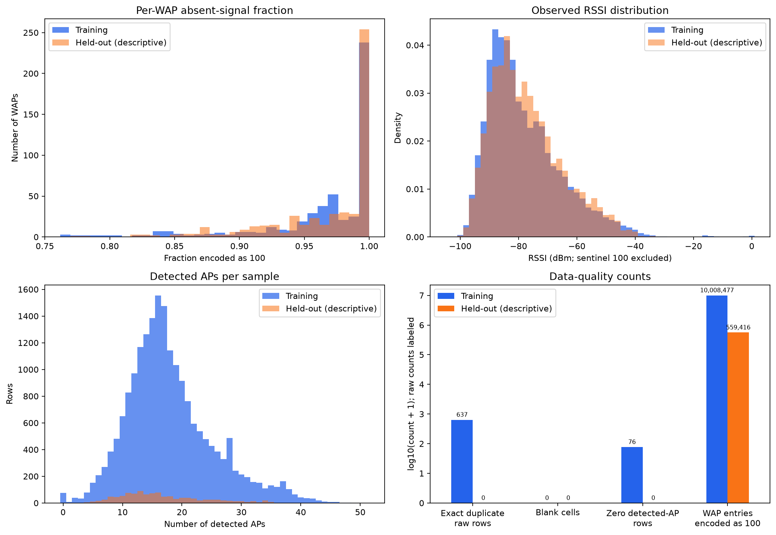
Workstream 1 · Dataset quality and EDA
A scan is a sparse fingerprint: absence is the dominant signal state.
96.54%
training WAP entries use sentinel 100
637
exact duplicate training rows retained
76
all-absent training scans retained
No blank cells in the supplied files
PROJECT 9 • AML VIVA • 04
Notes:
The EDA found 96.54% of training WAP entries encoded as 100, 637 exact duplicate training rows, and 76 training rows where all access points were absent. These were counted and retained; there are no blank cells in either supplied file. The figure contrasts training with the held-out file descriptively. Source: ML_01 notebook and data/figures/ml_01_data_quality_eda.png.

Slide 5
Workstream 1 · Missing-aware preprocessing
Keep signal strength and signal presence as separate information.
Scale observed RSSI
Raw WAP values
Decode absence
per-WAP statistics
from internal train only
Shared model table
520 columns
100 means absent
replace sentinel 100
with missing state
scaled RSSI + masks
+ raw-signal summaries
Presence masks
one binary seen / absent
flag per WAP
Apply the learned scaler unchanged to internal validation and held-out rows.
Targets, row IDs, user / phone IDs, and collection metadata stay outside the predictor allowlist.
PROJECT 9 • AML VIVA • 05
Notes:
The sentinel 100 is treated as an absent reading. For each WAP, the implementation learns mean and population standard deviation from observed internal-training values, standardizes observed values, and applies the learned transform unchanged elsewhere. A separate binary mask preserves whether each access point was seen. Targets, keys, user/phone identifiers, and metadata are retained for auditing but excluded from predictors.

Slide 6
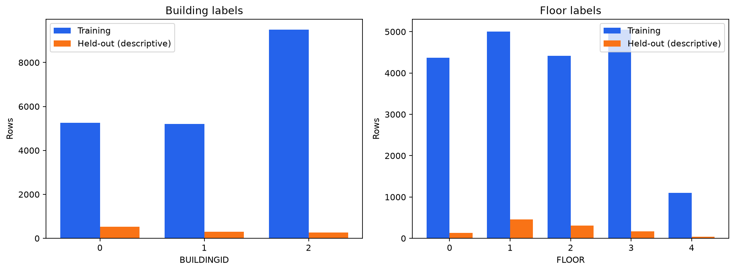
Workstream 1 · Feature output and safeguards
One shared feature contract feeds all downstream models.
1,046
predictor columns
•
520 standardized RSSI
Signal strength after train-only scaling.
•
520 presence indicators
Whether each WAP was observed.
•
6 signal summaries
Count heard, strongest RSSI, mean, standard deviation, strong-signal count, strongest WAP index.
Output files retain targets and metadata beside predictors for auditing.
PROJECT 9 • AML VIVA • 06
Notes:
The common predictor list has 1,046 features: 520 standardized RSSI columns, 520 binary presence masks, and six row-level summaries. The target distribution figure shows the class composition and the small held-out floor-4 support. Target and metadata columns remain in prepared outputs but are not in the model predictor allowlist. Source: ML_01 notebook, processed feature tables, and ml_01_target_distribution_eda.png.

Slide 7
Workstream 2 · Building model pipeline
Train a building classifier on the shared feature matrix.
Inputs
Candidate search
Selection rule
Final estimator
1,046 approved
signal predictors
18 Random Forest
configurations
best internal validation
accuracy; macro F1 tie-break
100 trees · leaf size 1
unlimited depth
Target: BUILDINGID · 3 building classes
Evaluation outputs: accuracy · macro F1 · class confusion counts
PROJECT 9 • AML VIVA • 07
Notes:
The building model is a RandomForestClassifier trained on the shared predictors. Eighteen parameter configurations were compared on internal validation. The selection criterion was accuracy, with macro F1 as tie-break. The chosen model uses 100 trees, unlimited depth, and minimum leaf size one. The supplied held-out file is used only for final evaluation.

Slide 8
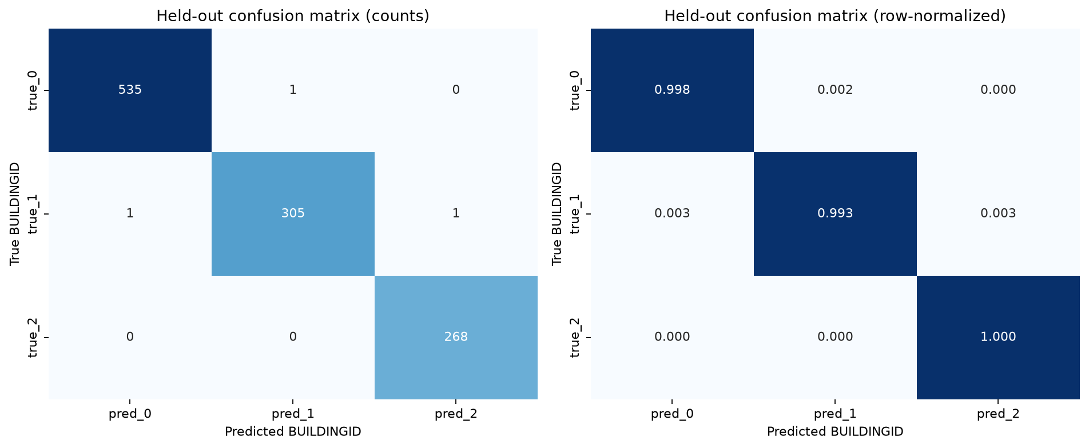
Workstream 2 · Building results
All three building labels are classified correctly in nearly every held-out row.
99.73%
held-out accuracy
99.71%
held-out macro F1
1,108 / 1,111 correct
PROJECT 9 • AML VIVA • 08
Notes:
Held-out building accuracy is 99.72997% and macro F1 is 99.7126%. There are 1,108 correct predictions out of 1,111. The figure shows count and row-normalized confusion matrices; the off-diagonal cells account for three errors. These scores describe the supplied held-out partition and should not be generalized to unseen buildings without a matching evaluation design.

Slide 9
Workstream 2 · Reading the building matrix
The confusion matrix shows three errors, each involving a neighboring building code.
•
Building 0
535 correct · 1 predicted as building 1.
•
Building 1
305 correct · 2 errors, one in each adjacent class.
•
Building 2
268 correct · no held-out errors.
The classifier is strong on this file; the grouped split and fingerprint-overlap checks still define what the score means.
PROJECT 9 • AML VIVA • 09
Notes:
The count matrix contains 535, 305, and 268 true positives for building codes 0, 1, and 2. Three errors occur: one code 0→1, one code 1→0, and one code 1→2. Code 2 has no errors. Preserve the evaluation caveat: there is no exact full raw-row overlap between the supplied files, but exact WAP vectors recur between internal train and internal validation; this score does not prove robustness to unseen fingerprints.

Slide 10
Workstream 3 · Floor labels and model pipeline
Keep the floor-code mapping fixed from training through final evaluation.
Encode labels
Address imbalance
Tune candidates
Evaluate once
derive floor-code map
from training labels
class-weighted
Random Forest
8 configurations
select by macro F1
held-out accuracy
macro F1 + confusion matrix
Five floor codes · code 4 is the smallest held-out class.
Class weights and macro F1 keep minority-class performance visible.
PROJECT 9 • AML VIVA • 10
Notes:
Floor labels are mapped from training data and then applied consistently to training, validation, and held-out rows. A class-weighted RandomForestClassifier compares eight configurations on internal validation and selects by macro F1. The target distribution figure makes the small floor-code 4 support visible.

Slide 11
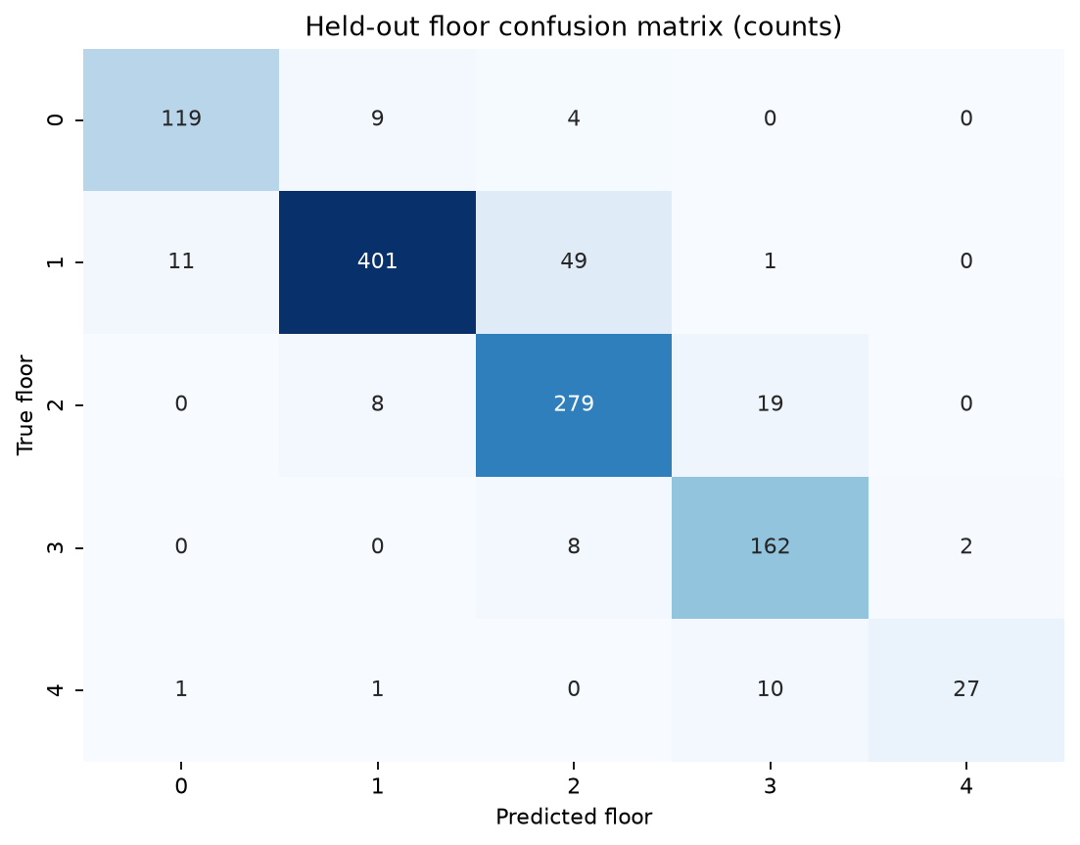
Workstream 3 · Floor confusion matrix
Most errors are between adjacent floor codes.
88.93%
held-out accuracy
87.27%
held-out macro F1
Largest confusion
true 1 → predicted 2 · 49 rows
PROJECT 9 • AML VIVA • 11
Notes:
Held-out floor accuracy is 88.9289% and macro F1 is 87.2655%. The largest off-diagonal count is true floor code 1 predicted as code 2, with 49 records. Confusion is primarily among nearby codes, so the matrix complements the aggregate scores.

Slide 12
Workstream 3 · Minority floor performance
Floor 4 has limited held-out support and the weakest recall.
39
held-out floor-4 rows
27 / 39
correct floor-4 predictions
Floor-4 recall: 69.23%
Report class-level errors with overall accuracy and macro F1.
PROJECT 9 • AML VIVA • 12
Notes:
Floor code 4 has only 39 records in the held-out partition. The matrix has 27 true positives, giving recall 69.23%. This smaller class contributes equally to macro F1, which is why macro F1 and the confusion matrix are needed alongside overall accuracy.

Slide 13
Workstream 4 · Coordinate regression pipeline
Predict longitude and latitude together, then evaluate per-axis and joint error.
Coordinate targets
Candidate search
Selection metric
Selected model
longitude + latitude
paired outputs
10 Random Forest
configurations
mean Euclidean error
on internal validation
150 trees · leaf 1
max_features = 0.5
Outputs
Longitude MAE · Latitude MAE · Euclidean error distribution · spatial error map
Coordinate labels use EPSG:3857 in the notebook; the repository does not independently verify the CRS.
PROJECT 9 • AML VIVA • 13
Notes:
The coordinate model is a multi-output RandomForestRegressor predicting longitude and latitude. Ten candidates are ranked on internal validation mean Euclidean error. The selected model has 150 trees, unlimited depth, minimum leaf size one, and max_features 0.5. It generates per-axis MAE, row-level Euclidean errors, and maps/plots. The notebook labels the coordinate system EPSG:3857 metres; the repository does not verify that CRS independently.

Slide 14
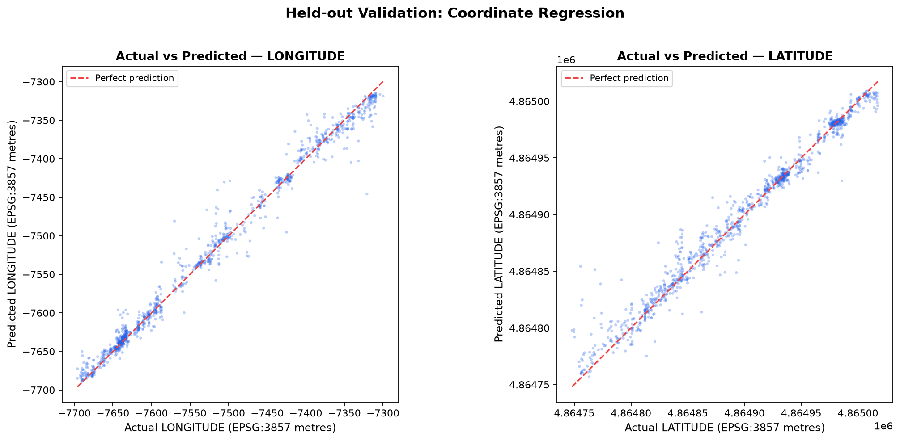
Workstream 4 · Actual versus predicted coordinates
The scatter points cluster around the perfect-prediction line, with visible outliers.
8.10
longitude MAE
6.81
latitude MAE
Reported coordinate units*
*Notebook CRS label is not independently verified.
PROJECT 9 • AML VIVA • 14
Notes:
The plot shows held-out actual versus predicted longitude and latitude, with the dashed red diagonal as perfect prediction. The horizontal/vertical scatter around the line represents error; a few larger misses are visible. Longitude MAE is 8.0966 and latitude MAE is 6.8064 reported units. Units inherit the notebook’s CRS label, which has not been independently verified.

Slide 15
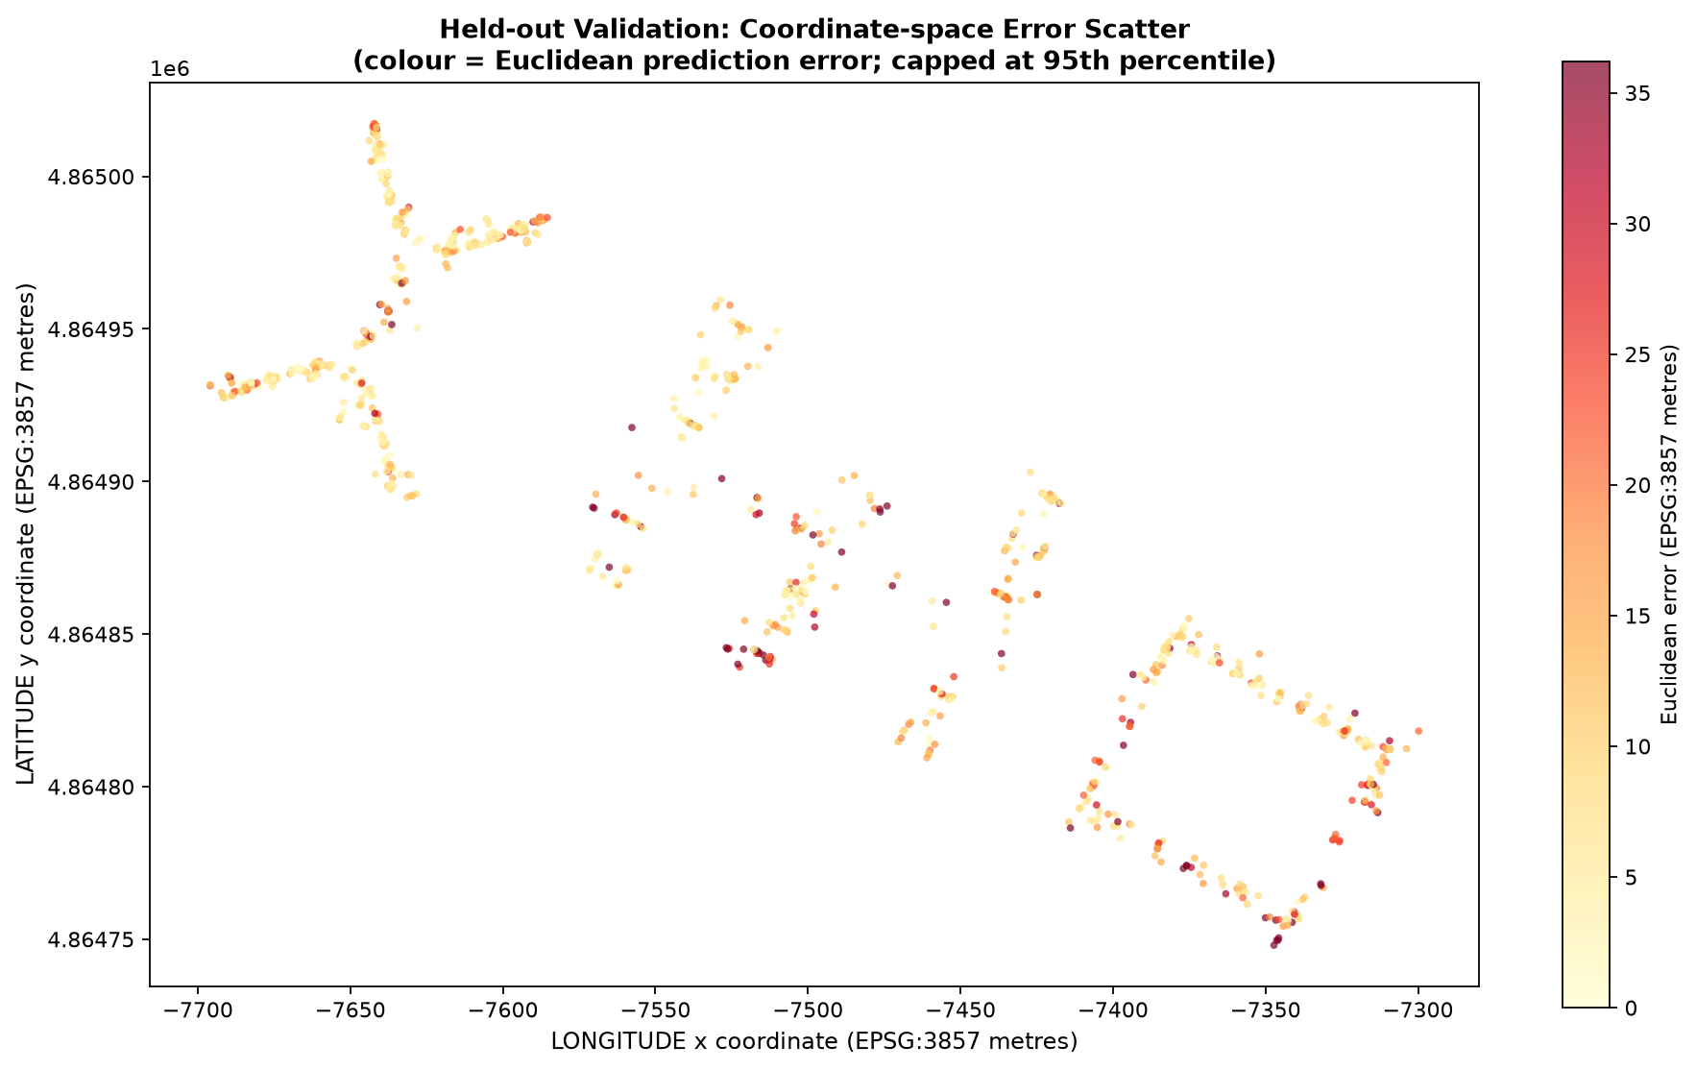
Workstream 4 · Where coordinate errors occur
The error map shows error magnitude at each held-out coordinate.
Colour encodes
Euclidean error
Large residuals appear at scattered positions rather than as one uniform offset.
Read the colour scale in the figure; extreme points stretch the range.
PROJECT 9 • AML VIVA • 15
Notes:
The held-out coordinate error map places true positions on the x/y plane and colors each position by Euclidean prediction error, capped at the 95th percentile in the figure. It makes spatially localized larger misses visible. Source: data/figures/ml_04_coordinate_error_map.png.

Slide 16
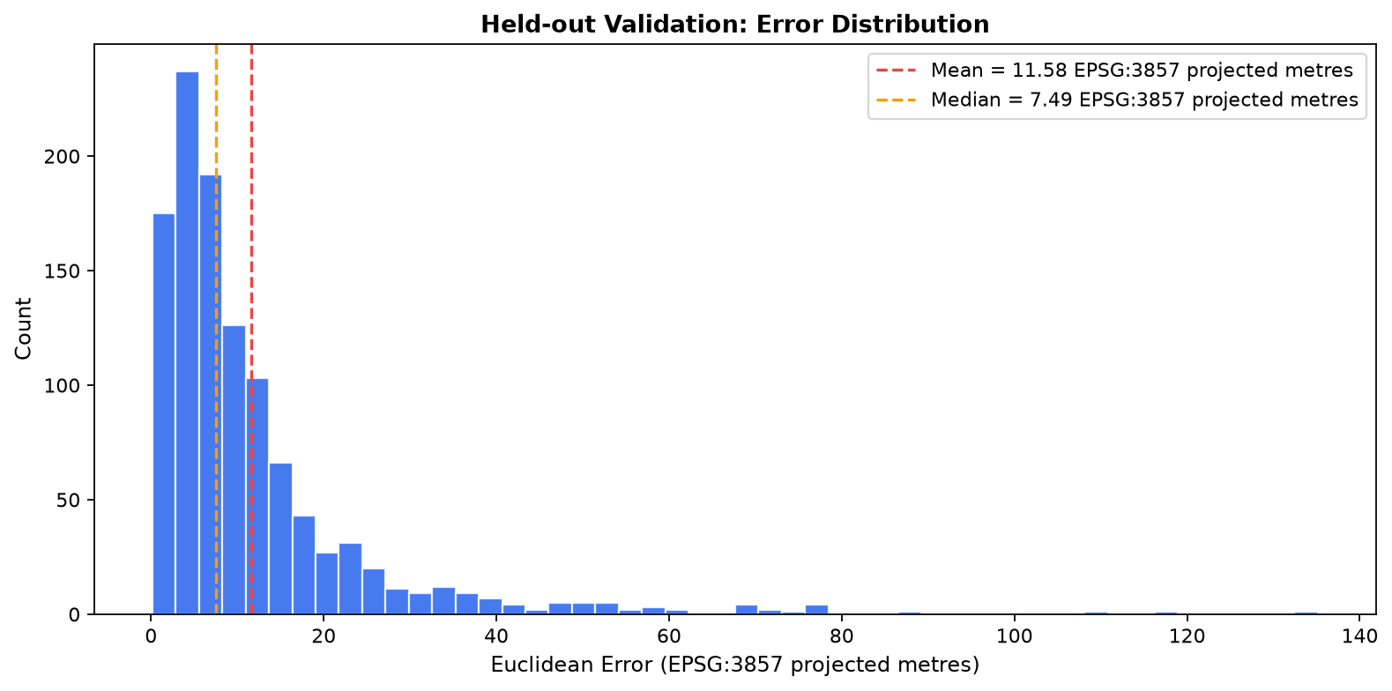
Workstream 4 · Coordinate error distribution
A right tail pulls the mean above the median.
11.58
mean Euclidean error*
7.49
median error*
36.21
95th percentile*
*reported coordinate units
PROJECT 9 • AML VIVA • 16
Notes:
The held-out mean Euclidean error is 11.5836; median 7.4884; and 95th percentile 36.2126 reported coordinate units. The histogram compares internal validation and held-out errors and shows a right-skewed tail. The notebook’s meter label depends on an unverified coordinate reference system.

Slide 17
Workstream 5 · Integration pipeline
Join predictions by partition and row ID before measuring joint outcomes.
Task outputs
Join on keys
Validate alignment
Integrated evaluation
building class
floor class
coordinate pair
source partition
+ stable row ID
row coverage
true labels
duplicates / gaps
task metrics
confusion matrices
hierarchical coordinate error
This step confirms every result refers to the same held-out observation.
Groups: both classes correct · building correct / floor wrong · building wrong / floor correct · both wrong
PROJECT 9 • AML VIVA • 17
Notes:
Member 5 joins task prediction files on source partition and row ID, verifies coverage and true labels, and recomputes the integrated task metrics. Joint building/floor correctness is then used to explain coordinate error across four groups. Sources: ML_05 integration notebook and saved integrated prediction tables.

Slide 18
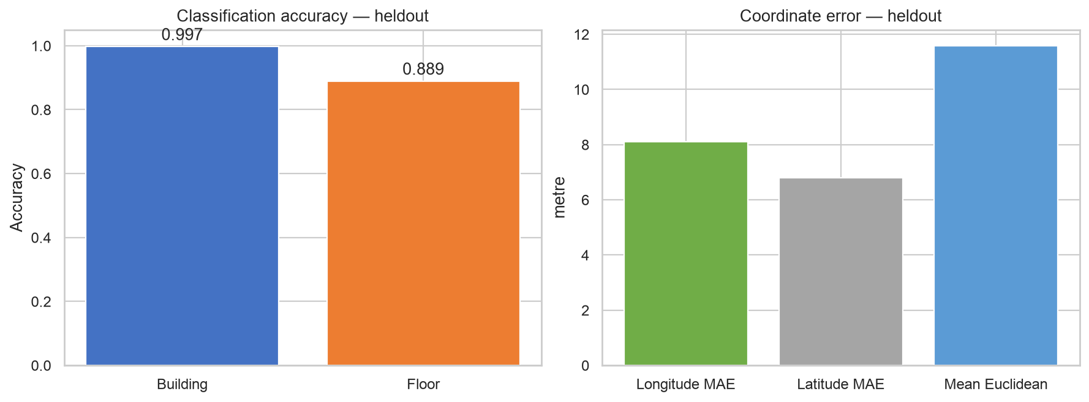
Workstream 5 · Integrated held-out metrics
Classification accuracy and coordinate error use different scales and meanings.
Classification
Building 99.73%
Floor 88.93%
Coordinate error*
Mean Euclidean 11.58
*reported coordinate units
PROJECT 9 • AML VIVA • 18
Notes:
The integrated summary compares held-out building and floor accuracy with longitude MAE, latitude MAE, and mean Euclidean error. These metrics are not directly comparable because the classifications are proportions and the coordinate measures are distances. Source: ml_05_heldout_metric_comparison.png and AML summary metrics table.

Slide 19
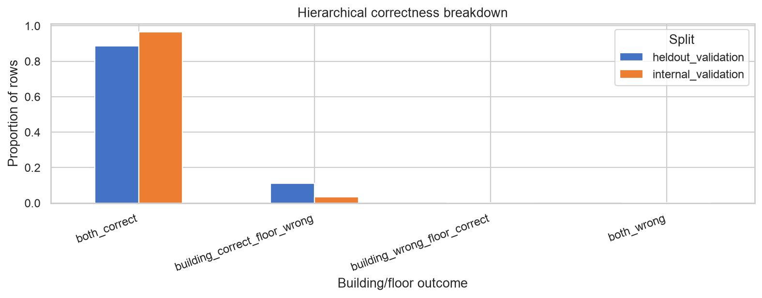
Workstream 5 · Hierarchical error analysis
Building and floor correctness provide context for coordinate error.
Held-out
986 / 1,111
both building + floor correct · 88.75%
10.00
mean coordinate error in that group
Only 3 records have a building error.
PROJECT 9 • AML VIVA • 19
Notes:
Of 1,111 held-out records, 986 (88.75%) have both building and floor correct and mean coordinate error 10.00 reported units. 122 records have building correct and floor wrong; two have building wrong and floor correct; one has both wrong. Tiny groups are descriptive only. Source: hierarchical breakdown CSV and figure.

Slide 20
Conclusion
The finished AML pipeline produces three task-specific estimates from a shared signal representation.
Building
Floor
Coordinates
99.73%
88.93%
11.58
held-out accuracy
held-out accuracy
mean Euclidean error*
What the project establishes
Comparable AML results on the supplied split, with an auditable shared preprocessing and integration path.
What the scores do not establish
Performance on wholly unseen fingerprints / positions; authoritative coordinate units or CRS.
*Coordinate units follow the notebook label; CRS not independently verified.
PROJECT 9 • AML VIVA • 20
Notes:
Conclude with the three held-out results and their limits. Building accuracy 99.73%; floor accuracy 88.93%; mean Euclidean coordinate error 11.58 reported units. Exact WAP vectors recur between internal train and internal validation, and coordinate pairs repeat across development and held-out partitions. These results should not be claimed as unseen-fingerprint or unseen-position performance. CRS/metre interpretation also remains unverified.

Slide 21
References
Dataset, benchmark, and method sources used in the AML work.
[1] UJIIndoorLoc dataset
UCI Machine Learning Repository, dataset 310.
DOI: 10.24432/C5MS59 · archive.ics.uci.edu/dataset/310/ujiindoorloc
[2] Dataset paper
J. Torres-Sospedra et al., “UJIIndoorLoc: A new multi-building and multi-floor database for WLAN fingerprint-based indoor localization problems,” IPIN 2014, pp. 261–270.
DOI: 10.1109/IPIN.2014.7275492
[3] Random Forest
L. Breiman, “Random Forests,” Machine Learning, vol. 45, pp. 5–32, 2001.
DOI: 10.1023/A:1010933404324
[4] Project implementation
Signal2Space repository: AML notebooks 01–05, processed data tables, saved figures, and AML report.
Repository artifacts cited in slide speaker notes.
PROJECT 9 • AML VIVA • 21
Notes:
Reference list. DOI links: https://doi.org/10.24432/C5MS59 ; https://doi.org/10.1109/IPIN.2014.7275492 ; https://doi.org/10.1023/A:1010933404324 . Project implementation is in the Signal2Space repository, especially the AML notebooks 01–05 and data/figures, data/tables, data/processed.

Slide 22
Thank you
Questions
Indoor Location Prediction Using Wi-Fi Signals
Notes:
Invite questions. Use the next slide for source references.

